Slide 1
Motor controller
Pre-internship Assignment
Infineon
Chirag Kotian, 3rd year B.Tech Electrical Engineering, IIT Tirupati

Slide 2
Introduction
Our aim is design, build, and test a compact controller for a brushless DC (BLDC) motor suitable for driving the joint of a cobot
Theory
Research
Implementation
Further works

Slide 3
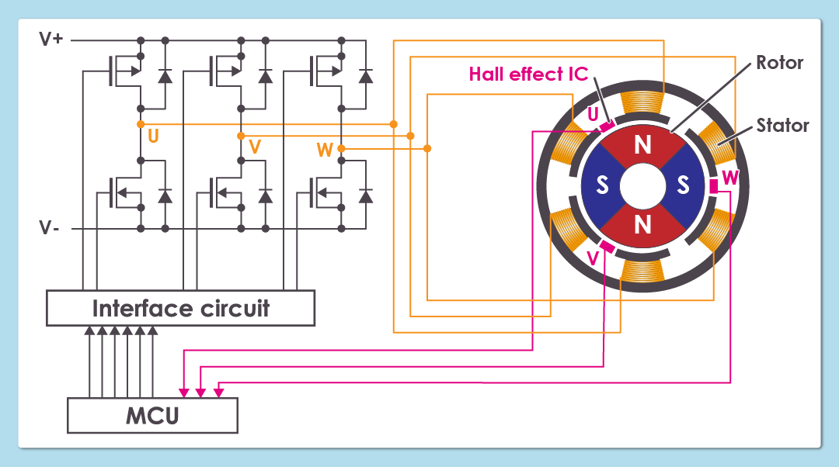
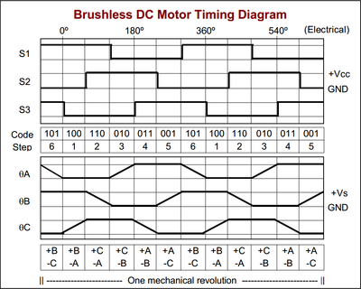
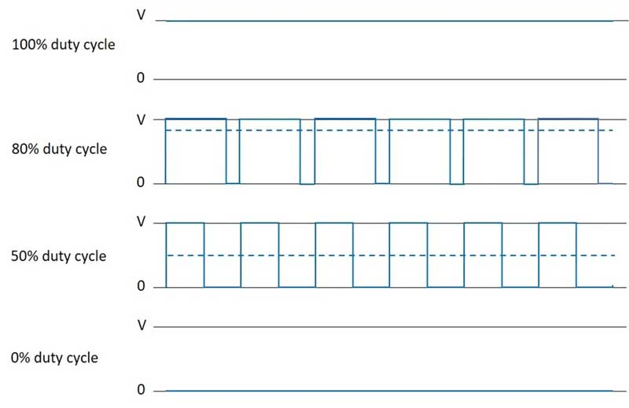
Theory
Let’s first have a look at Brushless Motor, types of commutation and controlling BLDC motors and why GaNs. We will also see what is switching losses and how to minimize them in GaNs section.
Brushless Motor
Types of Commutation
Why GaNs

Slide 4
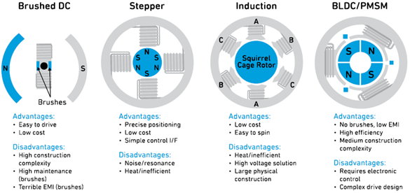
Few Types of Motors

Slide 5
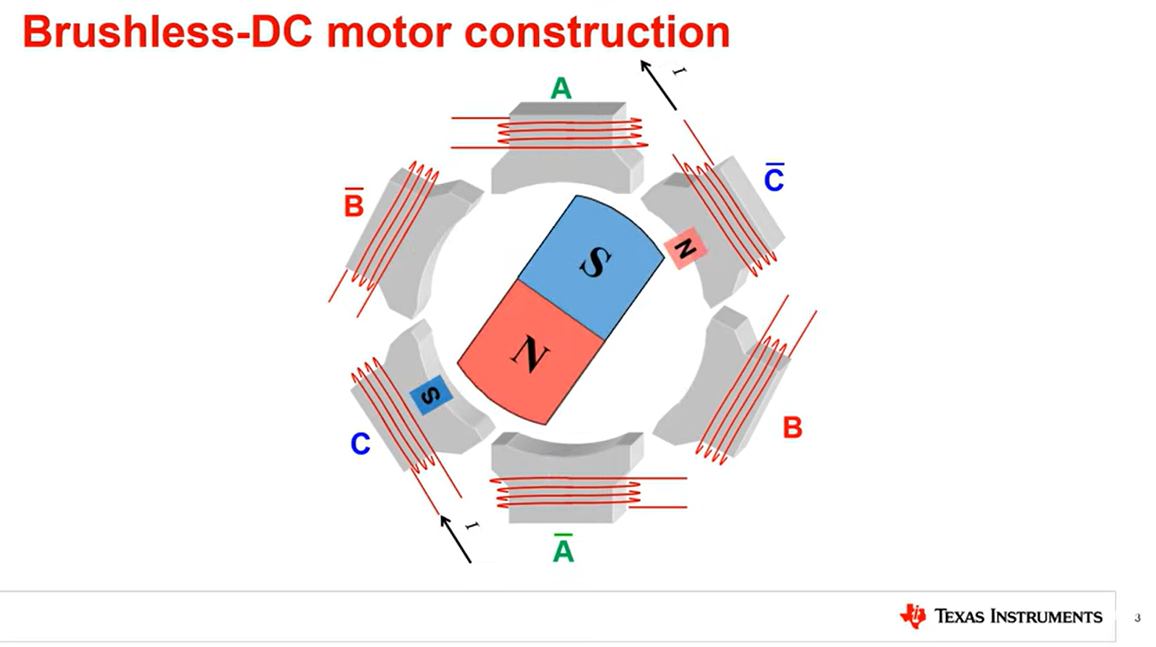
Brushless Motor

Slide 6
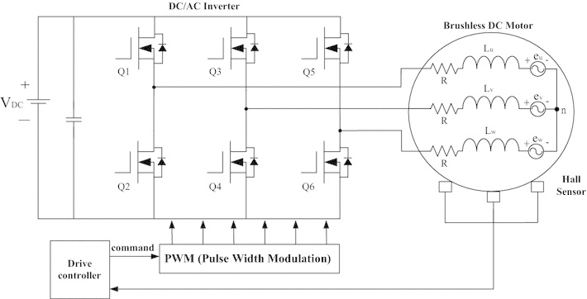
Three Phase H-Bridge Inverter

Slide 7
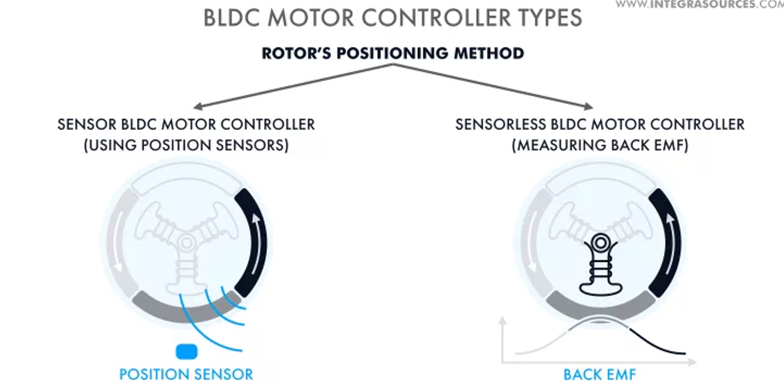
Position Feedback

Slide 8
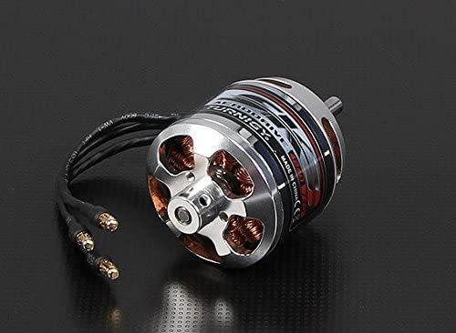
Motor Params
Given specs:
4-5s (13.6V - 21V)
Motor : Turnigy Aerodrive SK3 -4240-740kv
Poles : 14 V/Hz : 0.045420136
Resistance (ohm) : 0.0151
Kv (rpm/V) : 660.5
Inductance (uH) : 11.85833333
Torque constant (Nm/A): 0.011276989
Rated current (A) : 50
Desired torque (Nm) : 0.3
Operating current (A): 26.60284548
Operating speed (rpm) : 3000
Operating power (W) : 94.24777961
Coil reactance (ohm) : 0.003725405
What we want:
Motor RPM: 0-3000RPM Gearbox : 100:1 Torque : 30Nm Input : 48-60V min.40V Min. size and weight of power cables internal to the cobot

Slide 9
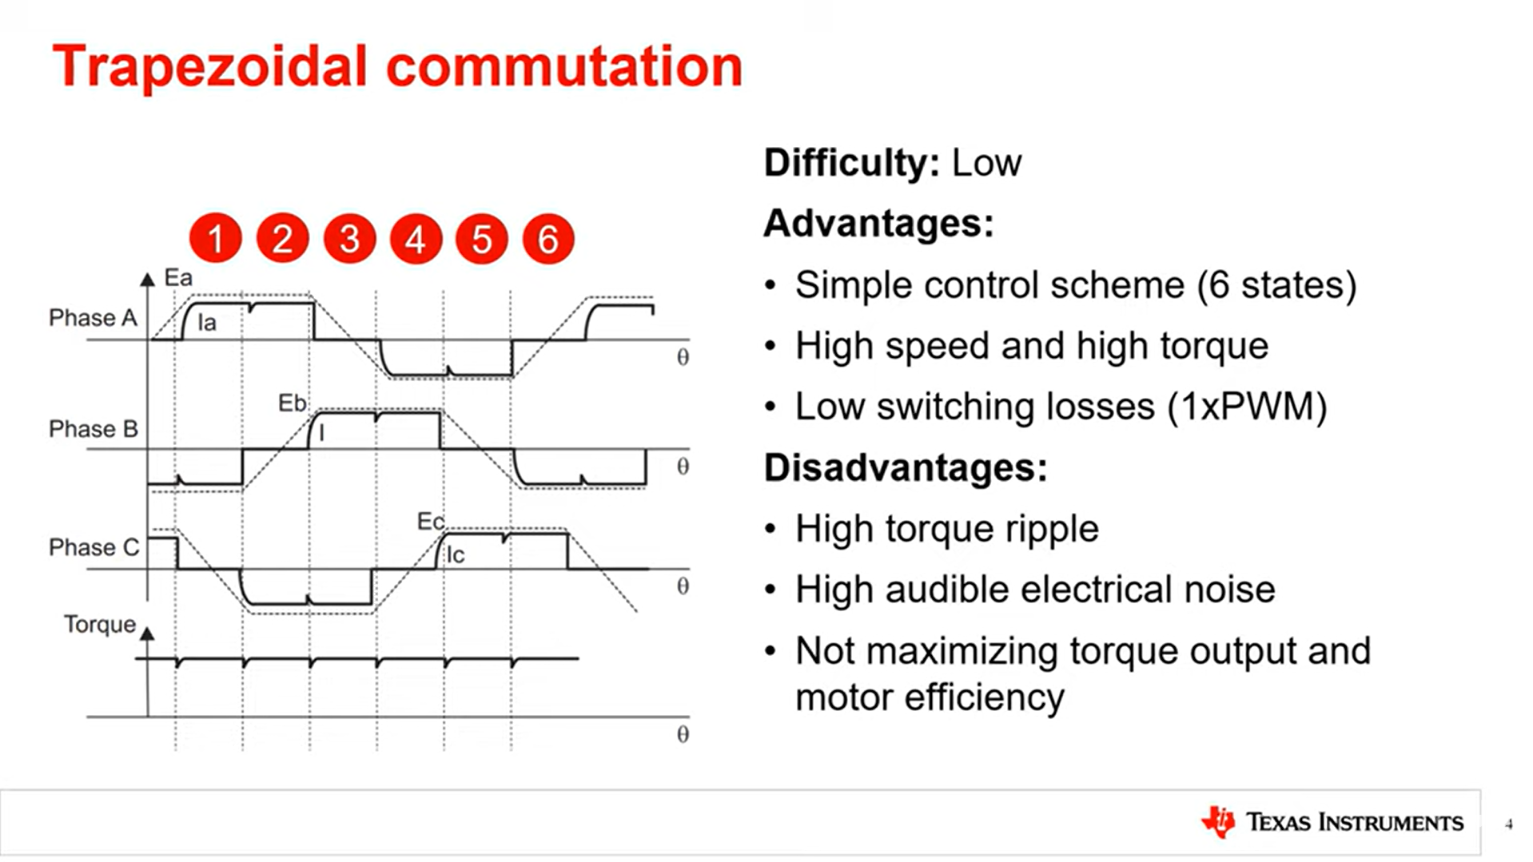
Trapezoidal commutation
Used widely in brushless motor ESCs

Slide 10
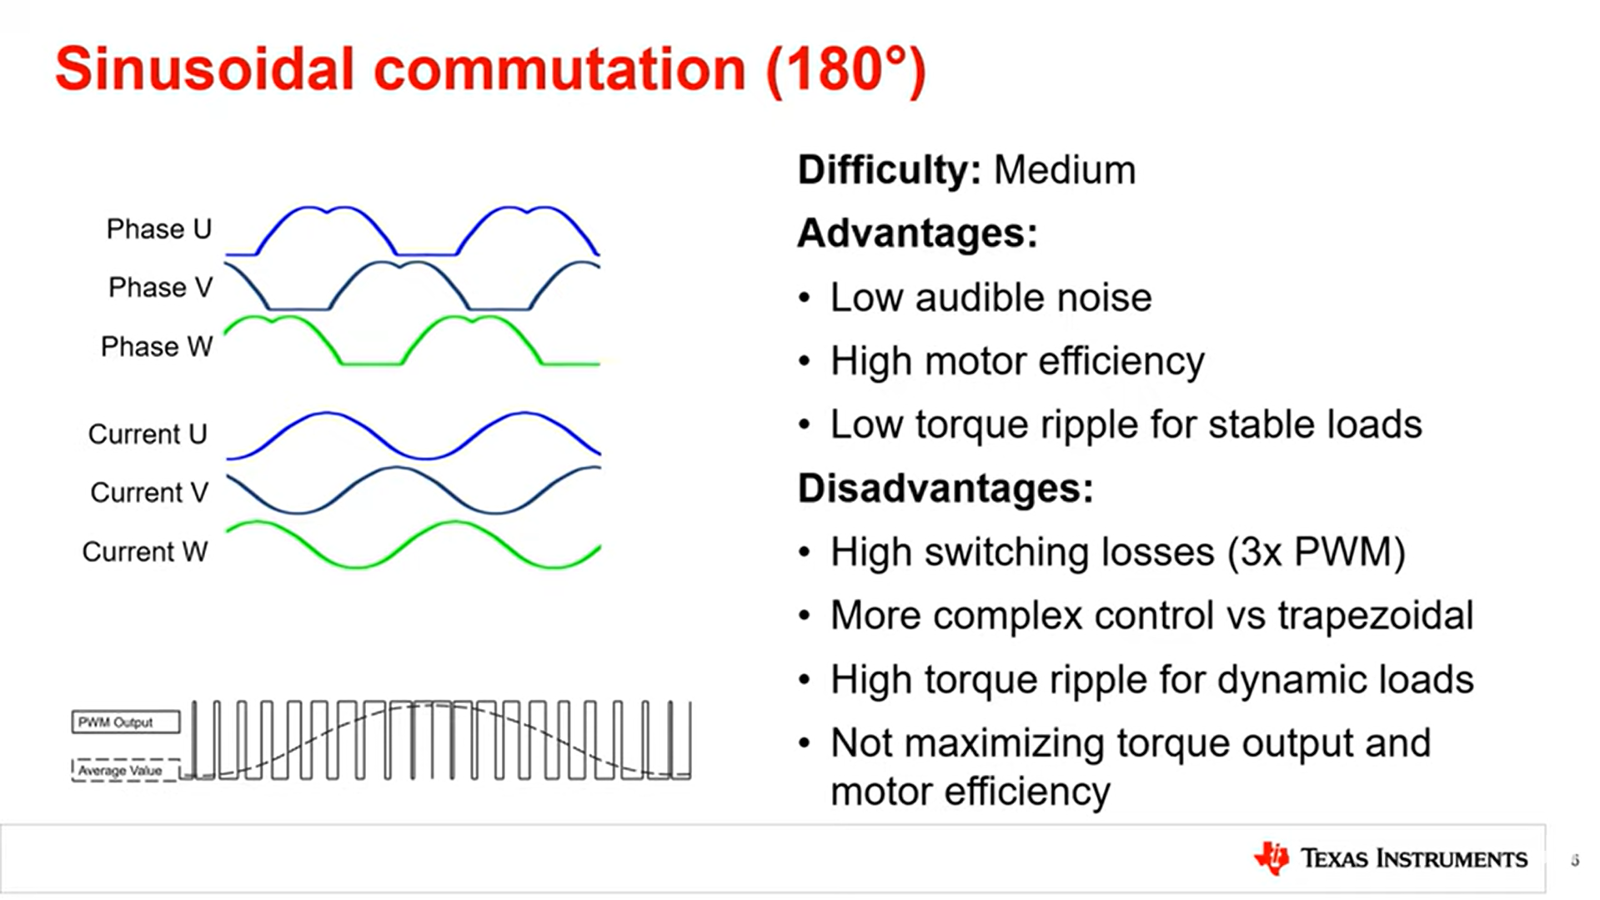
Sinosoidal commutation

Slide 11
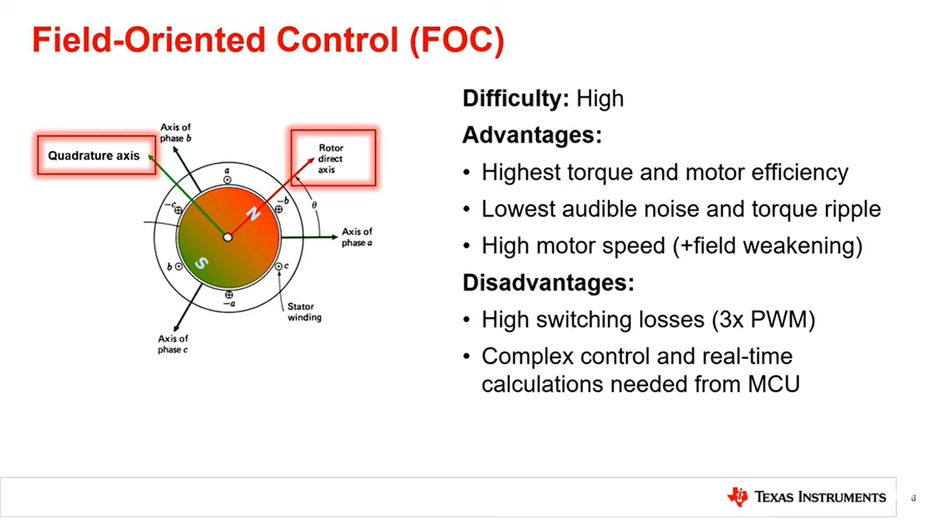
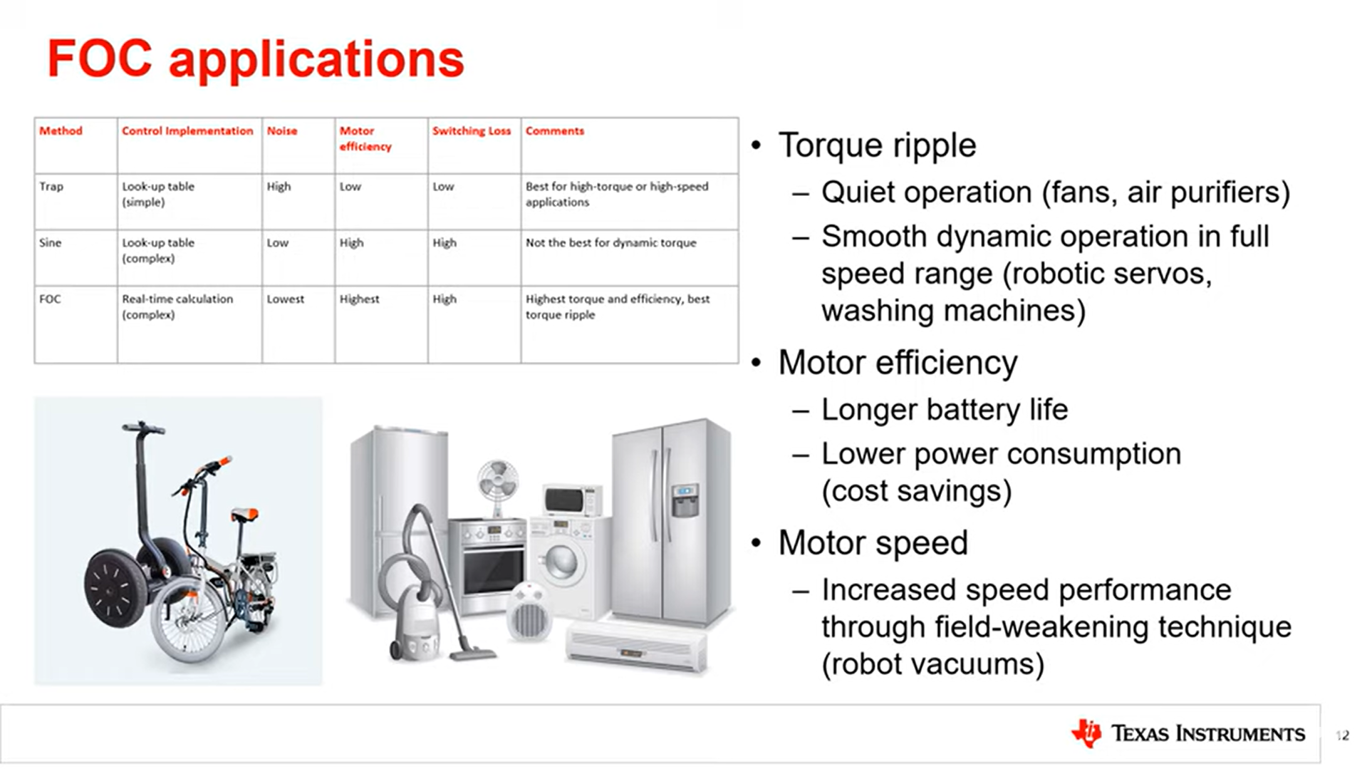
Field Oriented Control(FOC)

Slide 12
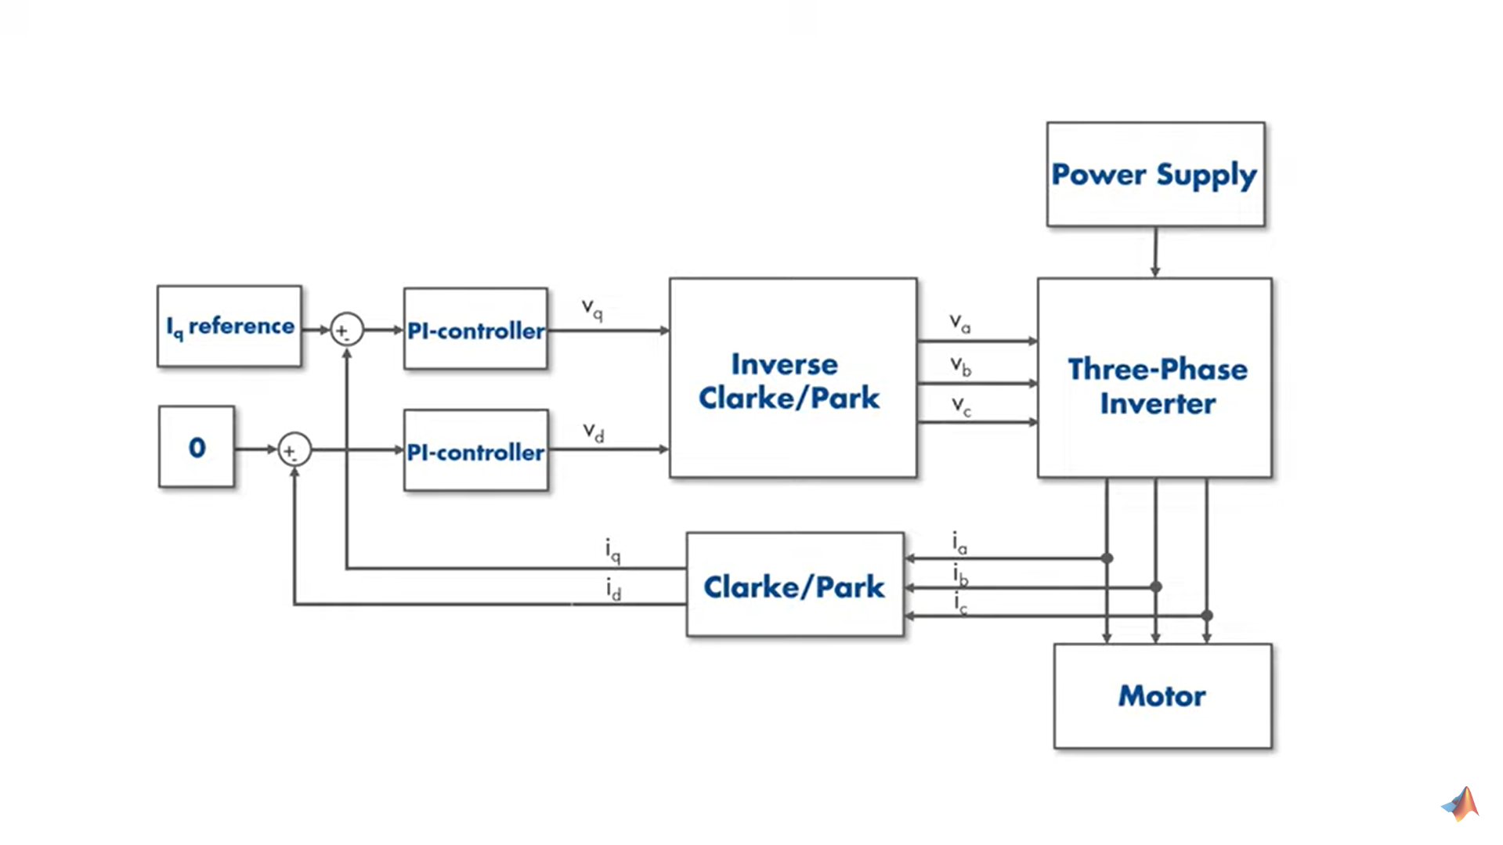
Field Oriented Control(FOC)

Slide 13
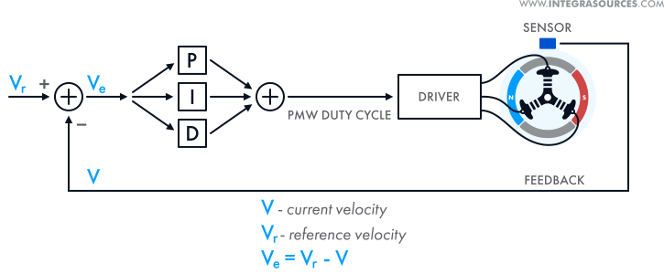
How to implement PID/PI control loop

Slide 14
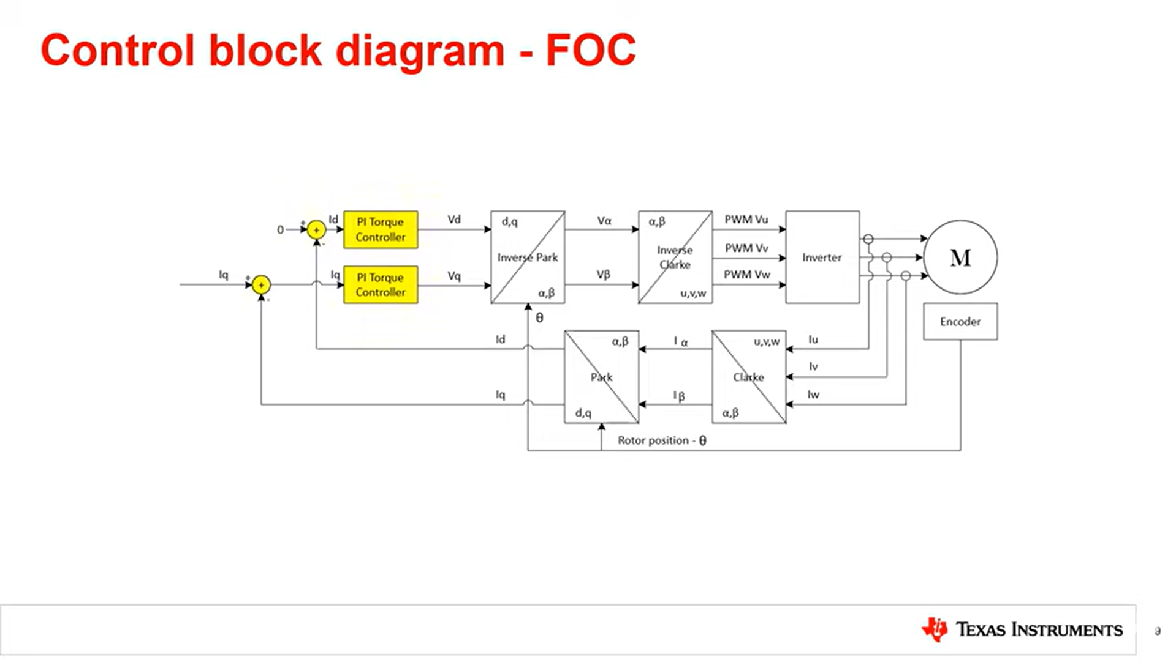
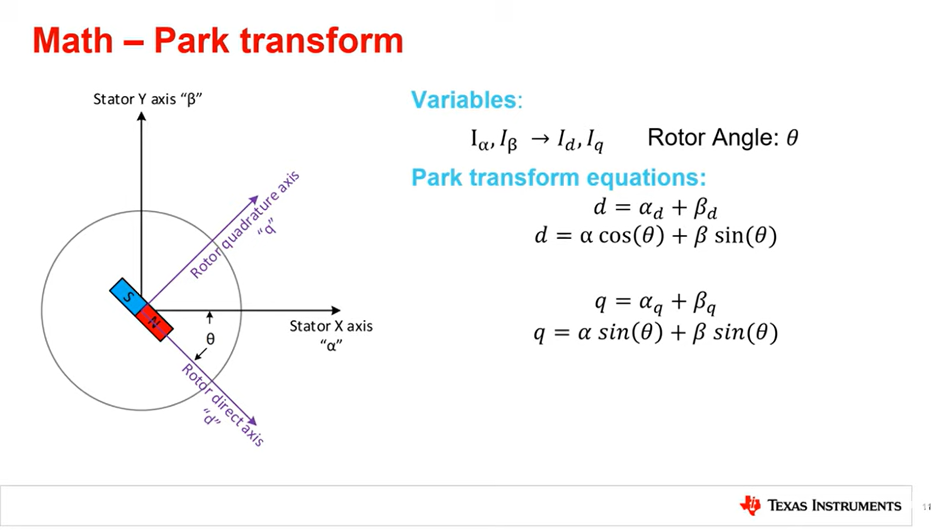
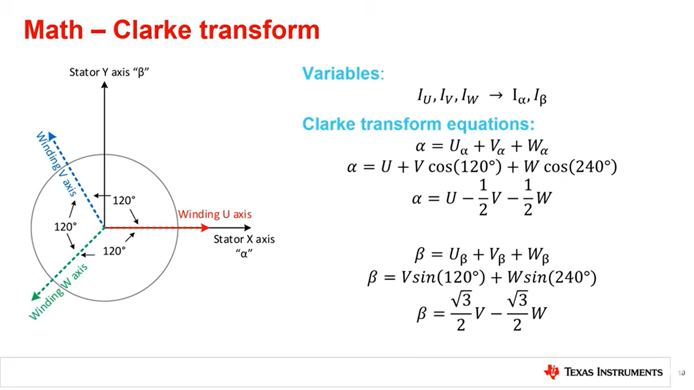
Calculations and Controls in Field Oriented Control(FOC)

Slide 15
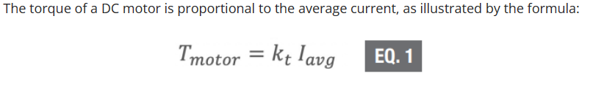
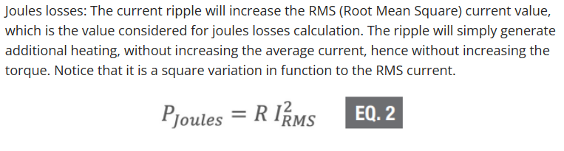
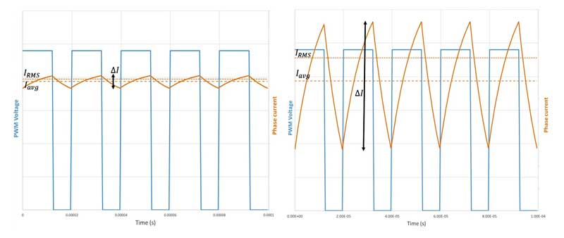
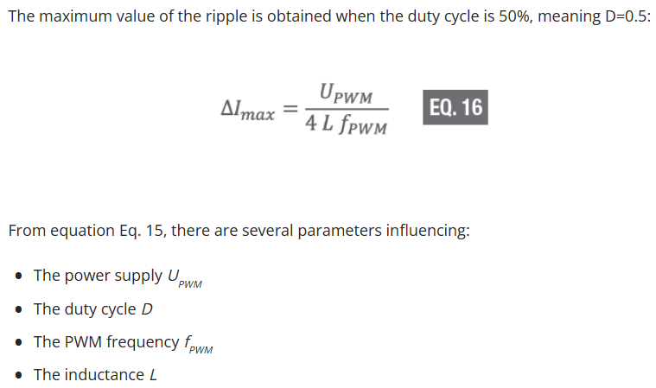
Why GaNs: PWM and frequency
PWM used for current and voltage control (Duty cycle)

Slide 16
Why GaNFETs: PWM and frequency
Determining the PWM (Pulse Width Modulation) frequency for a brushless motor involves considering several factors including motor characteristics, drive circuitry, and control requirements.
Motor Characteristics: The PWM frequency should be high enough to ensure smooth motor operation and minimize audible noise, especially at low speeds. However, it should not be excessively high to avoid increasing switching losses in the motor driver circuitry.
Switching Losses: Higher PWM frequencies result in increased switching losses in the motor drive circuitry, which can reduce overall efficiency and increase heat generation. Therefore, the PWM frequency should strike a balance between minimizing switching losses and ensuring smooth motor operation.
Control System Requirements: The PWM frequency should be compatible with the control system's sampling rate and response time requirements. Choosing a PWM frequency that aligns with the control system's dynamics can help optimize motor performance and response.
Drive Circuitry: The drive circuitry, including the motor driver ICs and power transistors, may have recommended or maximum PWM frequency specifications. It's important to ensure that the selected PWM frequency is within the limits specified by the drive circuitry to prevent damage and ensure reliable operation.
Noise Considerations: PWM frequency can affect electromagnetic interference (EMI) and audible noise produced by the motor and drive electronics. Selecting a PWM frequency that minimizes EMI and audible noise interference is important, especially in applications where electromagnetic compatibility (EMC) is critical.
Application Requirements: Consider the specific requirements and constraints of the application, such as speed range, torque control, and dynamic response. The PWM frequency should be selected to meet the performance and efficiency requirements of the application.
In normal ESCs, with SiC MOSFETs, PWM frequency of 50-80kHz is used

Slide 17
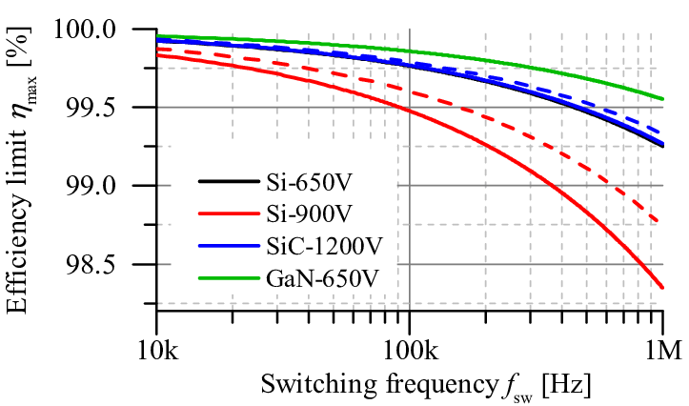
Why GaNFETs: PWM and frequency
In normal ESCs, with SiC MOSFETs, PWM frequency of 80kHz is used
We can use 200kHz PWM frequency for similar switching loses using GaNs instead of commonly used SiC (An SiC MOSFET e.g. is attached at the bottom with characteristics similar to selected GaNFET)
150% increase in frequency
60% reduction in ripple currrent

Slide 18
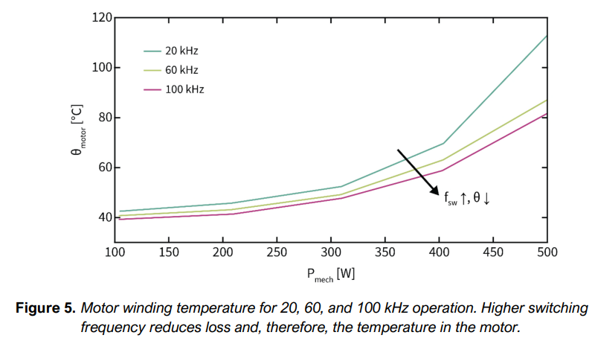
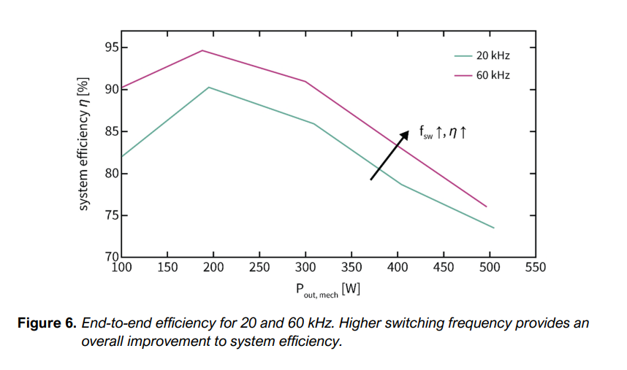
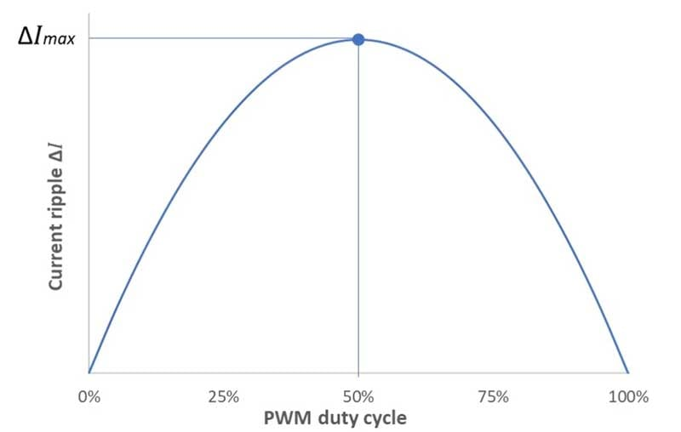
Why GaNs: PWM and frequency
PWM Duty Cycle:
MAX: 19/40=0.475 (47.5% @ Min Voltage)
MIN: 19/60=0.3167 (31.7% @ Max Voltage)

Slide 19
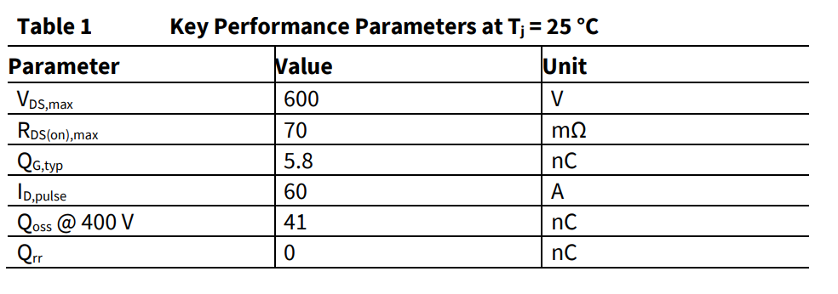
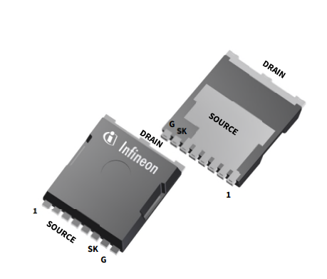
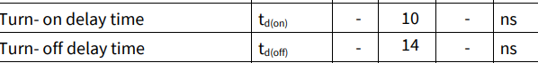
Selected GaNFET
Options Infineon Provided:
4 GaNs: -IGO60R070D1 -IGOT60R070D1 -IGLD60R070D1 -IGT60R070D1
(All have the similar Electrical Characteristics, just footprints are different)
We will be using IGT60R070D1
Max Frequency supported: 41.67 MHz

Slide 20
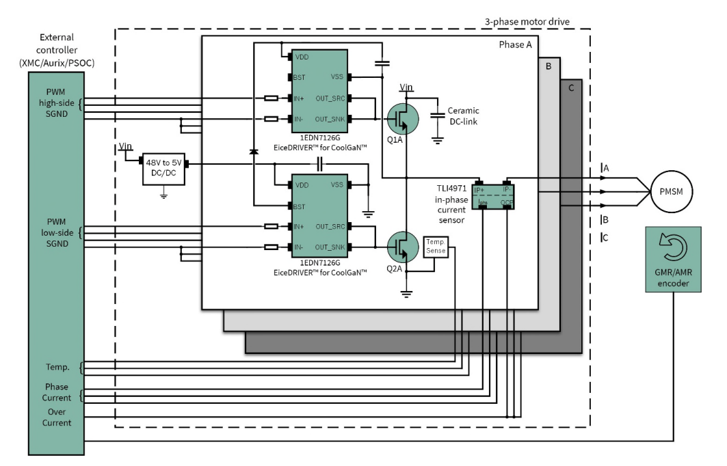
Recommended Circuit by Infineon
Recommended GaNFET driver:
1EDN7126G (EiceDriver for CoolGaN)
Recommended Current sensor:
TLI4971
Recommended MCUs or Controllers:
XMC
Aurix
PSOC
Recommended encoder
GMR
AMR

Slide 21
GaNFET driver
What is Gate Driver?
A gate driver is a power amplifier that accepts a low power input from a controller IC and produces the appropriate high current gate drive for a power device. It is used when a PWM controller cannot provide the output current required to drive the gate capacitance of the associated power device.
Recommended GaNFET driver - 1EDN7126G (EiceDriver for CoolGaN)
This driver along with GaNFETs can be used in motor drive applications, such as those used for robotics, drones, automotive, and industrial machinery where high switching frequencies enable higher power density, increased efficiency, higher performance, and reduced EMI. These benefits can make GaN-based motor drive systems more compact, reliable, and cost-effective than silicon-based systems.
Turn on, off propagation delay= 75ns impulse blanking time = 40ns(min time pulse on)
Max frequency= 1/((10+14+75+75+40)*10^-9) = 4.673MHz

Slide 22
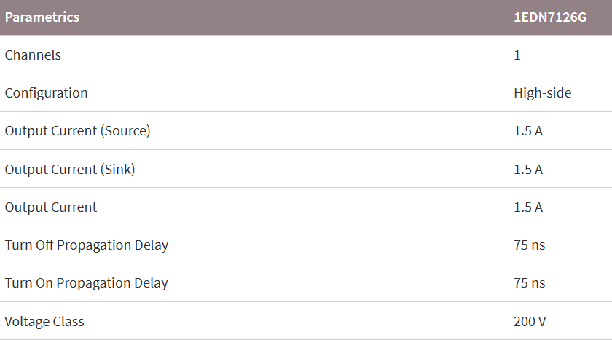
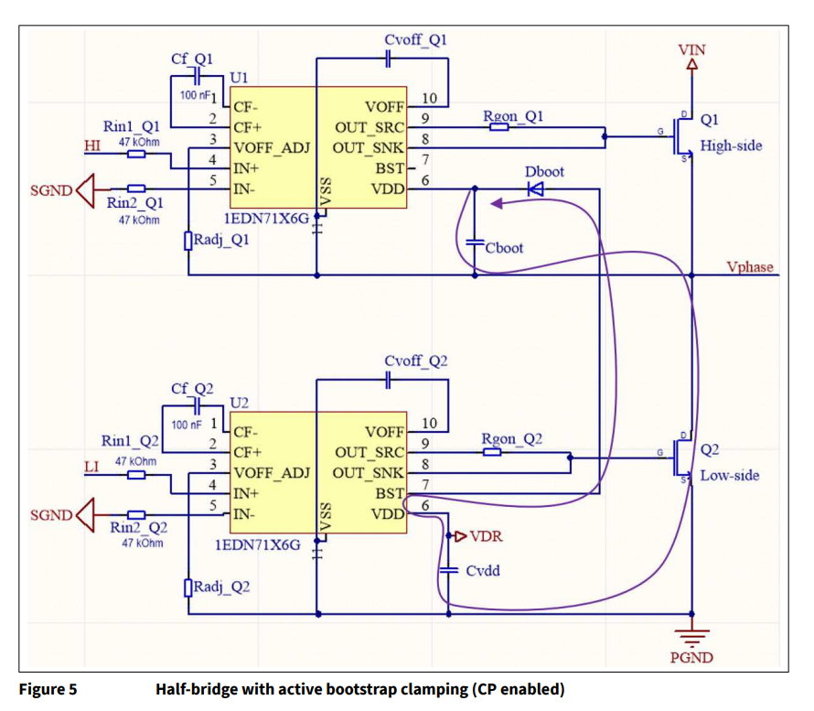
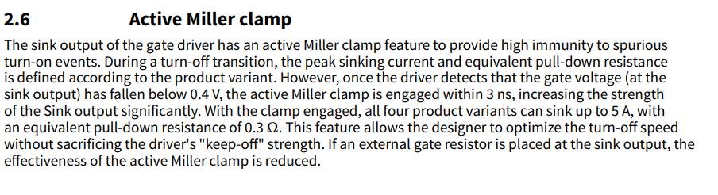
GaNFET driver

Slide 23
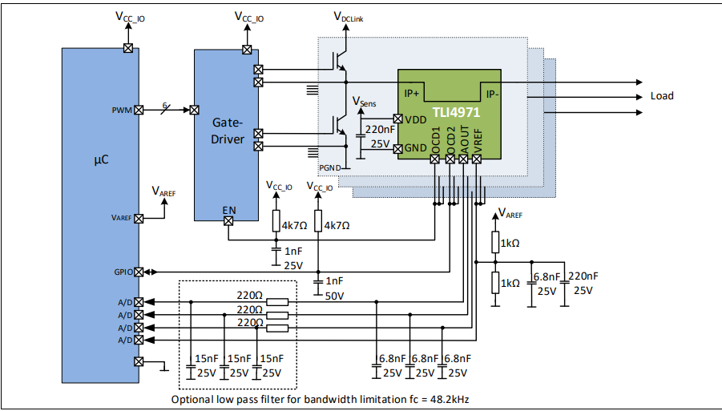
Current Sensor
The XENSIV™ TLI4971 Hall effect sensor avoids potential common-mode transient immunity (CMTI) issues with differential amplifiers. A well-isolated in-phase current sensor is more immune to voltage transients and provides accurate readings for field-oriented control of the motor.

Slide 24
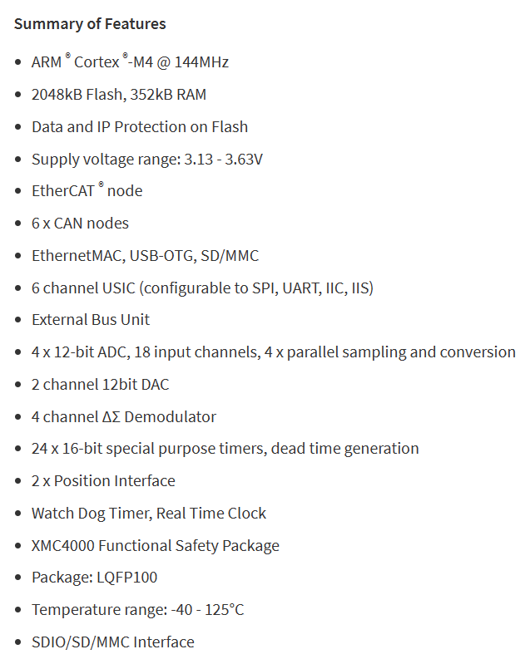
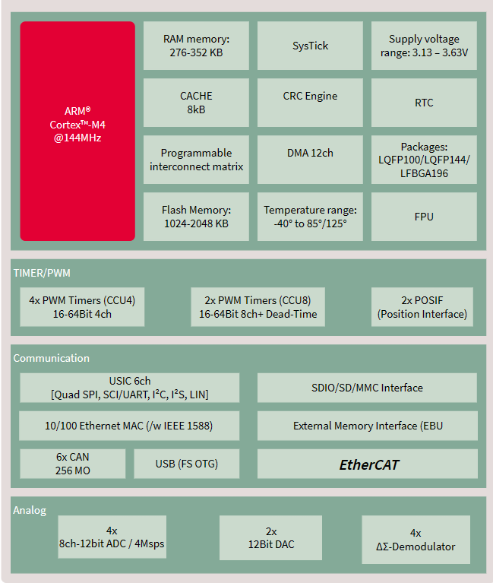
MCU
XMC4800-F100K2048 AA 144MHz
More than 9bits of PWM accuracy

Slide 25
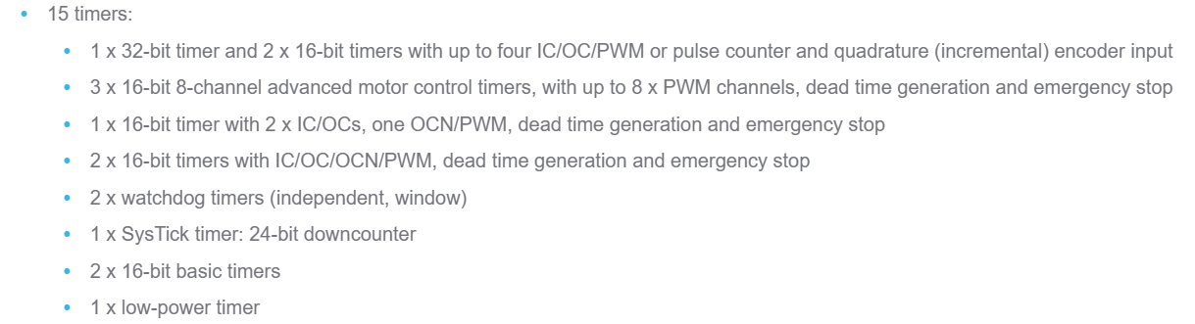
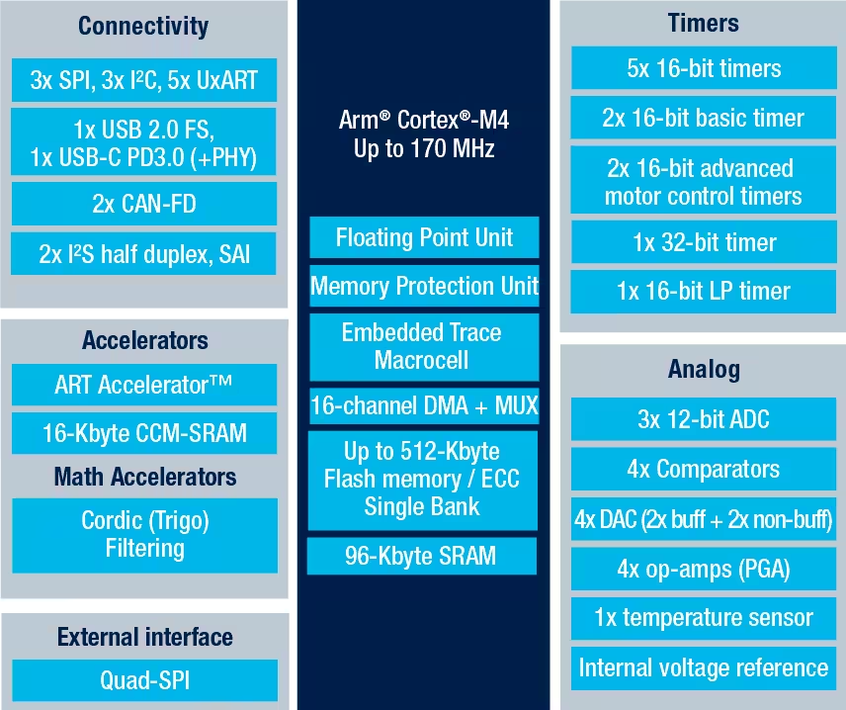

Alternative MCU
STM32G491RE ARM Microcontroller 170MHz, more than 9bits of PWM accuracy (Even more than XMC4800-F100K2048)

Slide 26
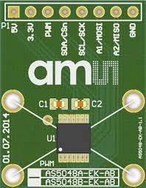
Encoder
Recommended encoder: Infineon XENSIV™ TLE5012 magnetic angle sensors with 0.01° resolution
In applications where a sensored FOC scheme is preferred, this encoder can be used for precise positioning.
Uses SPI protocol
Used Magnetic encoder: ams AS5048B
Used this because of SPI pin limitation on Arduino(PWM+SPI pin)
Magnetic encoder, no moving parts
0.02197 deg resolution
14 bit resolution
Used I2C protocol

Slide 27
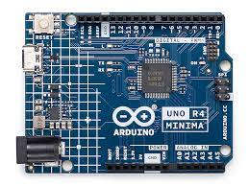
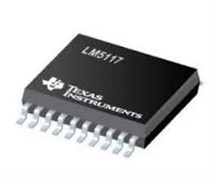
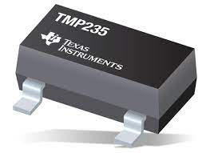
MCU board to be used for testing and Additional Component Details
Arduino unoR4 minima:
48Mhz Clock speed
8 bit resolution -> 200kHz (240)
voltage control resolution= 0.234375V @60V and 0.15625V @ 40V
PWM: D3,D5,D6,D9,D10,D11
A/D C: A0,A1,A2,A3,A4,A5 (Used by Temperature, Vref, Current)
OverCurr: D2,D4,D7
Analog Mux: SN74HC4851 8channel (D8,D12,D13)
For buck convertor: 7.5V, we can use LM5117
For temperature sensor: TMP236
±2.0°C analog output temperature sensor, with 19.5mV/°C gain

Slide 28
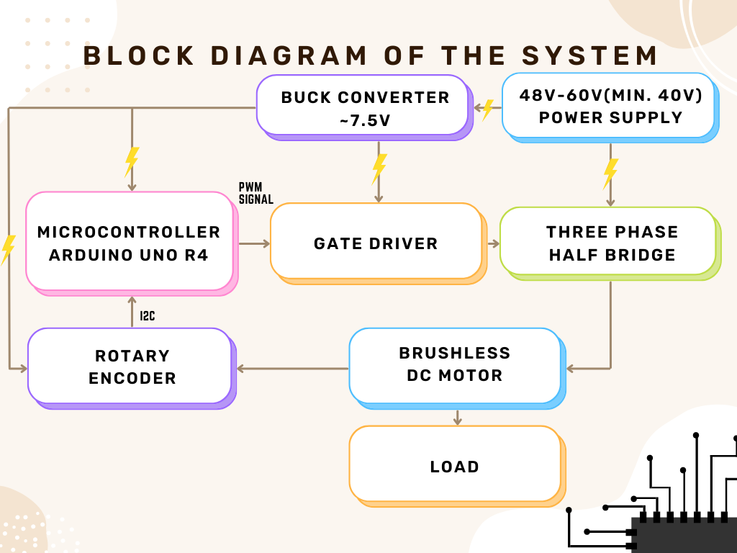

Slide 29
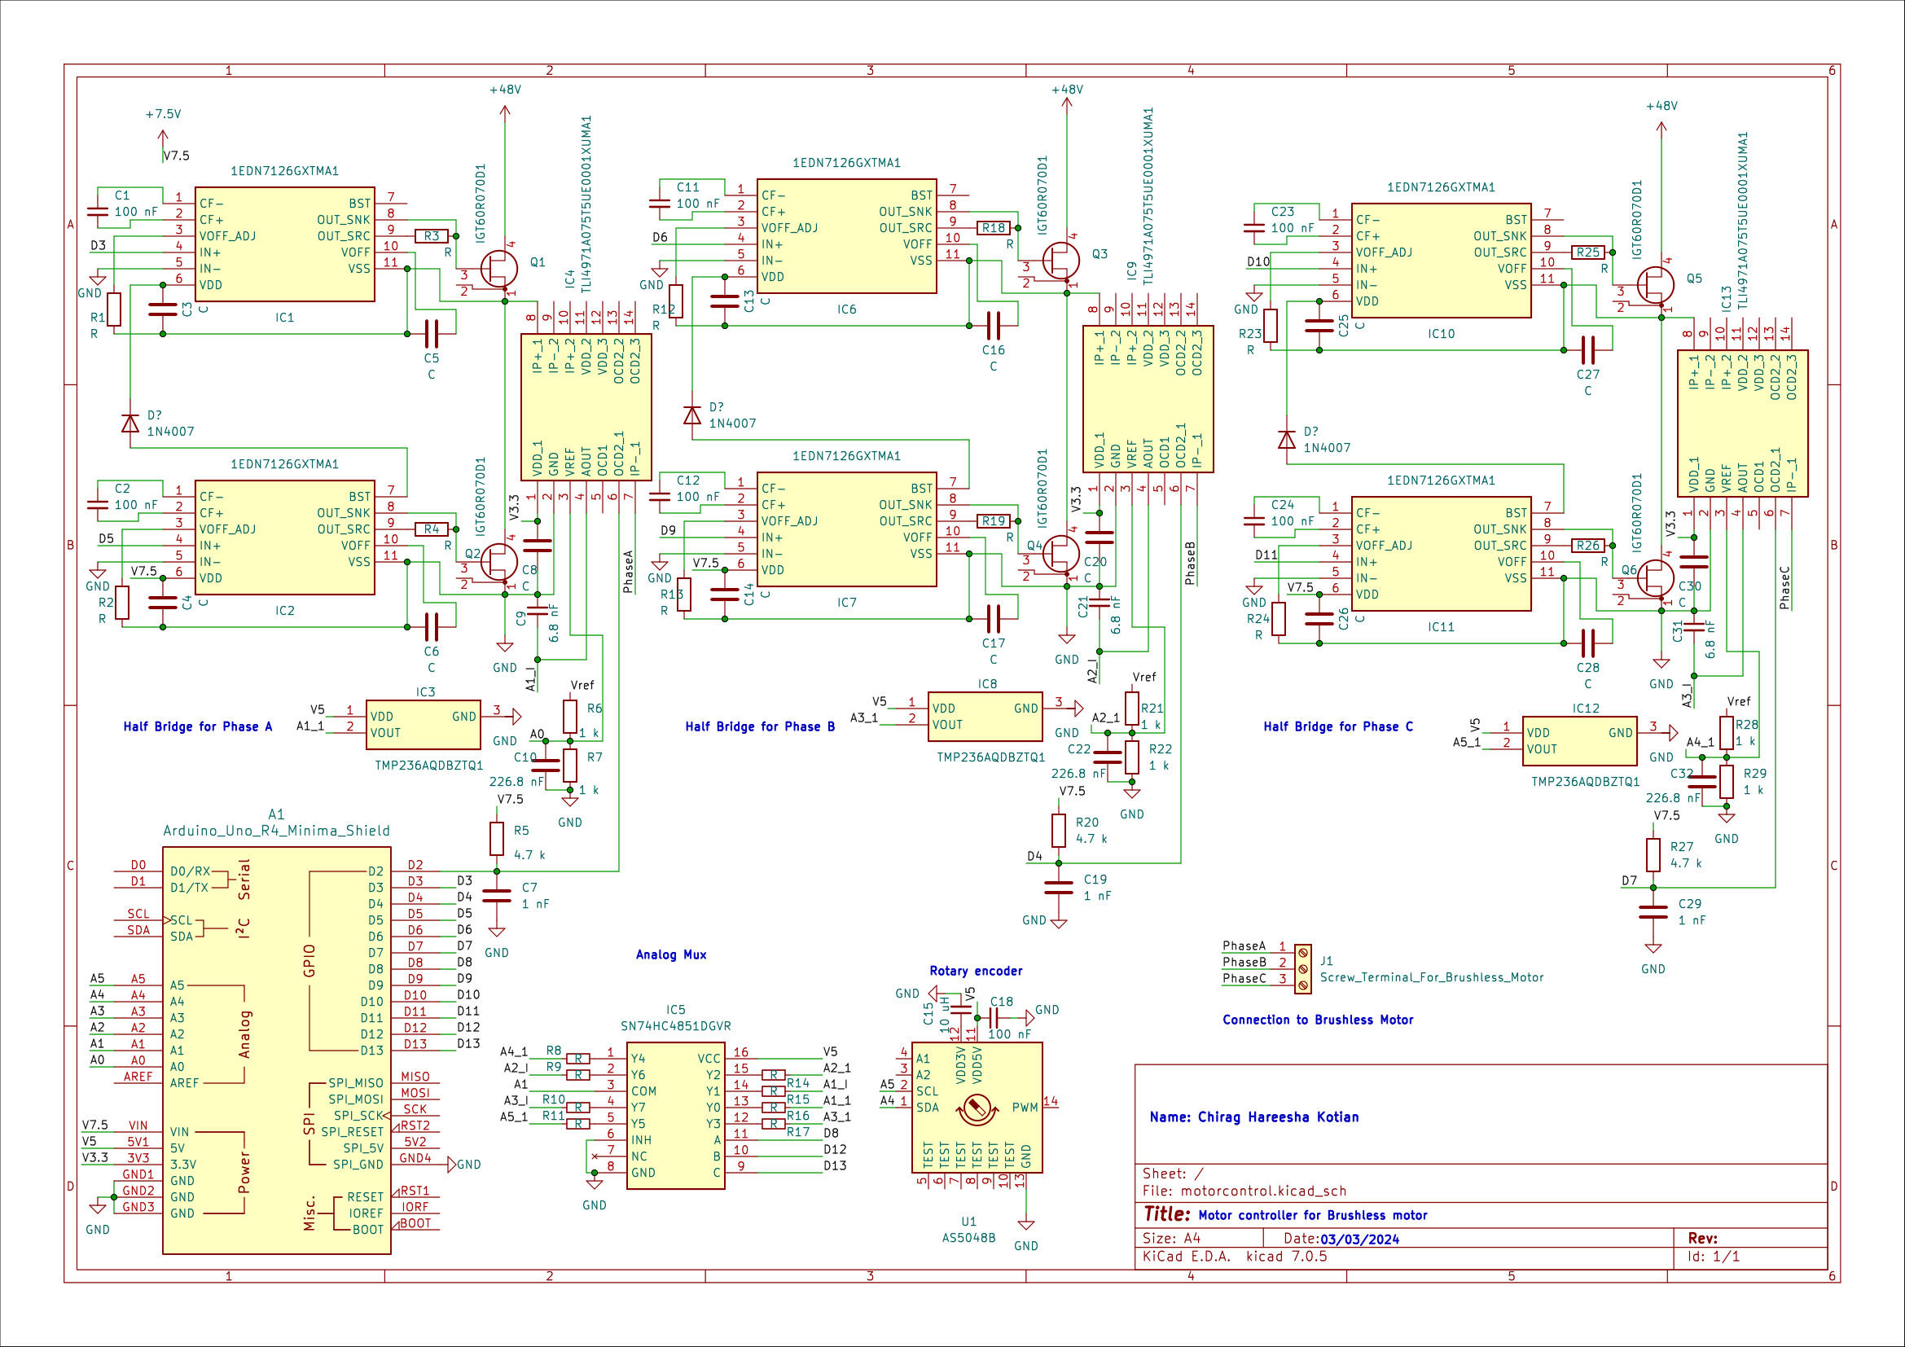
Circuit Schematic
Made using open-source KiCAD

Slide 30
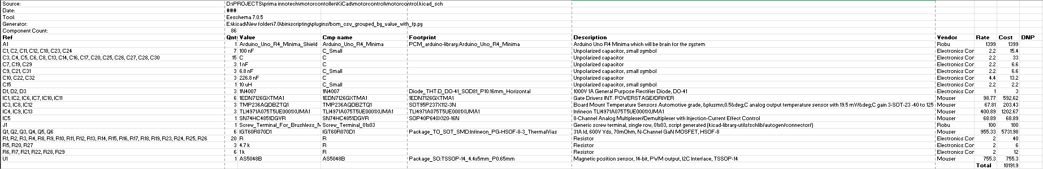
Bill of Materials

Slide 31
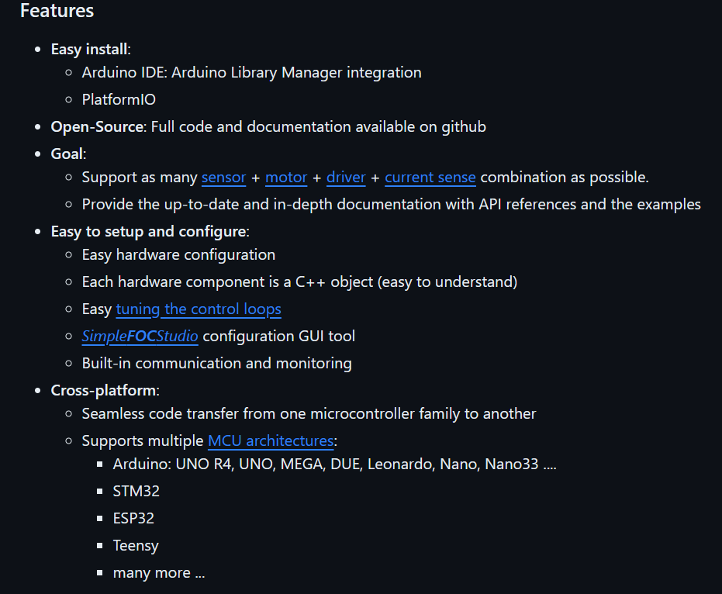

Open-source FOC library with many features
SimpleFOC
https://simplefoc.com/

Slide 32
Next Steps
Completing the schematic
Simulation, Improvement, PCB designing
Assembly and Testing

Slide 33
Reference Links
https://www.portescap.com/en/newsroom/whitepapers/2021/10/understanding-the-effect-of-pwm-when-controlling-a-brushless-dc-motor
https://www.portescap.com/en/newsroom/whitepapers/2021/10/understanding-the-effect-of-pwm-when-controlling-a-brushless-dc-motor
https://ams.com/documents/20143/36005/AS5147_DS000307_3-00.pdf
https://www.controleng.com/articles/understanding-the-effect-of-pwm-when-controlling-a-brushless-dc-motor/
https://www.infineon.com/cms/en/product/microcontroller/32-bit-industrial-microcontroller-based-on-arm-cortex-m/32-bit-xmc4000-industrial-microcontroller-arm-cortex-m4/
https://www.infineon.com/cms/en/product/microcontroller/32-bit-tricore-microcontroller/
https://www.infineon.com/cms/en/product/microcontroller/32-bit-psoc-arm-cortex-microcontroller/
https://github.com/simplefoc/Arduino-FOC
https://www.youtube.com/watch?v=Y5kLeqTc6Zk
https://www.youtube.com/watch?v=zSdetJsSeNw
https://www.youtube.com/watch?v=Nhy6g9wGHow
https://www.youtube.com/watch?v=YPD1_rcXBIE
https://github.com/byDagor/Janus-Controller
https://github.com/maakbaas/mbldc
https://github.com/qwertpas/O32controller
https://www.youtube.com/watch?v=VdkloigaxZo
https://github.com/SheffieldEcoMotorsports/motor-controller
https://simple-circuit.com/arduino-sensorless-bldc-motor-controller-esc/
https://www.instructables.com/BLDC-Motor-Control-with-Arduino-salvaged-HD-motor/
https://simple-circuit.com/arduino-sensorless-brushless-motor-bldc/
https://simple-circuit.com/arduino-bldc-brushless-dc-motor-control/
https://www.youtube.com/watch?v=_6-_jvZe7iA

Slide 34
Thank you
Chirag Kotian
+91 8591757109
ee21b025@iittp.ac.in
https://chiragkotian.github.io/

